Slide 1
Social-ecological scenarios and land-use models
Isabel Rosa
isabel.rosa@idiv.de
iDiv Summer School
27 August 2018,
Leipzig, Germany

Slide 2
Overview
Social-ecological scenarios and land-use models
Participatory scenario development and narratives
DPSIR framework/IPBES
Land-use change modelling from theory to practice
Exercise

Slide 3
Why do we need scenarios?
Environmental crisis
Learning from climate sciences
Bring scientific community together
Raise awareness
Antecipate potential tipping points
Global Conservation Targets
Aichi
Sustainable Development Goals

Slide 4
Global land use and land cover change (LULCC)
Driven by rapid human population growth and demand for agricultural and forestry products;
Second largest source of anthropogenic carbon emissions (van der Werf et al. 2009 Nature Geosci.);
High temporal and spatial variability in land use and land cover change patterns and rates.
Maxwell et al. 2016 Nature
Foley et al. 2005 Science
Gibbs et al. 2010 PNAS

Slide 5
Consequences of LULCC
As the landscape changes, there are major impacts on biodiversity, ecosystem services, and human well being, which can be aggravated by climate change (Pecl et al. 2017 Science);
Modeling can help us understand how landscapes change over time and space, its consequences on biodiversity, ecosystem services, and potential impacts on human well being;
By projecting future changes we can help decision and policy makers anticipate potential impacts.
Foley et al. 2005 Science
Cardinale et al. 2012 Nature

Slide 6
Lots of indicators out there to help understand what‘s going on
European Enviromental Agency developed a framework called DPSIR (Drivers, Pressures, State, Impact, Response model of intervention) for describing the interactions between society and the environment
Driving forces: e.g. industry, tourism, economic growth
Pressures: e.g. pollution, land-use change, population growth
States : e.g. water quality, soil quality, air quality, habitat, vegetation
Impacts : e.g. ill public health, habitat fragmentation, economic crisis, environmental damage, biodiversity loss
Responses : e.g. taxes, environmental laws,
Policy perspective

Slide 7
IPBES?

Slide 8
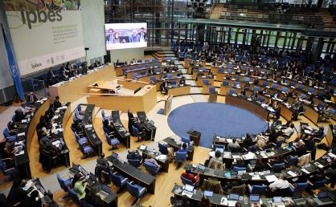
What is IPBES?
Intergovernmental Science-Policy Platform on Biodiversity and Ecosystem Services, established in 2012
Current membership includes 125 governments
Overall objective is to provide policy relevant knowledge on biodiversity and ecosystem services to inform decision making
Over a thousand scientists, nominated by governments and organisations, currently contribute to the work of IPBES
Notes:
The main purpose of this assessment is to provide guidance on the use of scenarios and models of biodiversity and ecosystem services to inform policy and decision-making in a variety of contexts …
… but with particular emphasis on their use in IPBES deliverables
This is a methodological assessment and the focus is therefore on methods, not on undertaking analyses using these methods
8

Slide 9
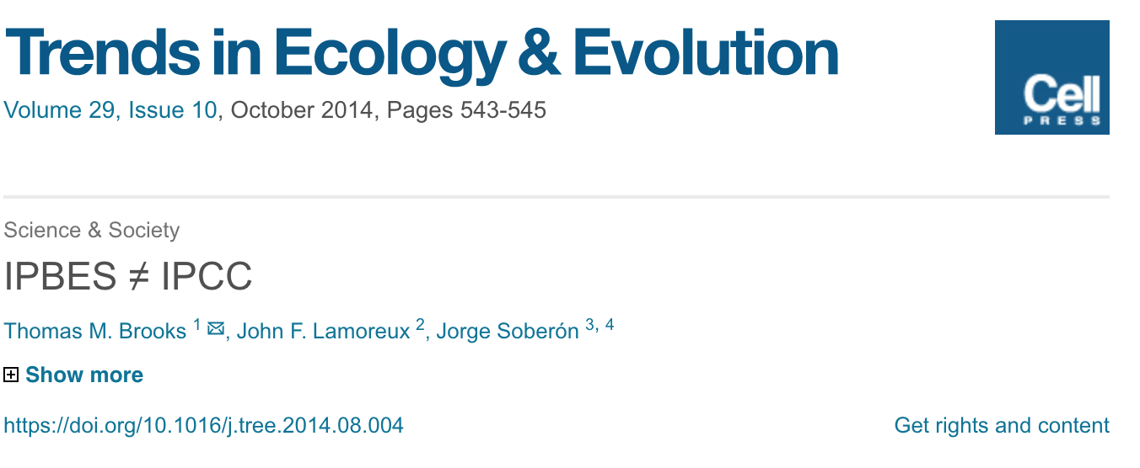
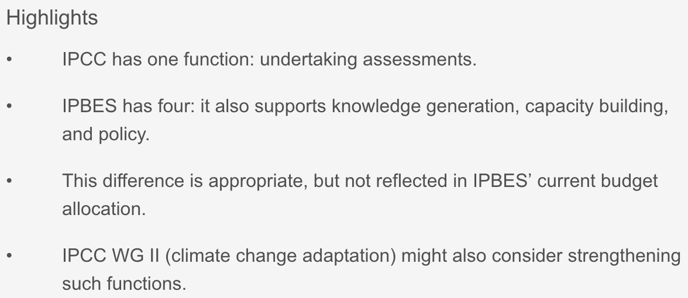
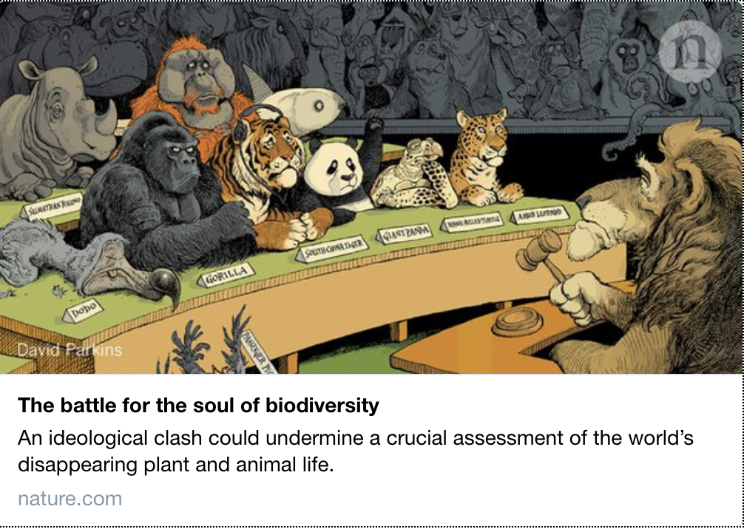
IPBES
Catalizes integrated science by bringing together many different scientists across the globe
Inspired by IPCC (papers IPBES != IPCC); Bringing together scientists working in complementary topics
Global, Regional, Thematic Assessments
Methodological Assessment Scenarios and Models

Slide 10
Purpose of the assessment
To provide expert guidance on the use of scenarios and models to inform policy-making and decision-making in a variety of contexts …
… with particular emphasis on the role of scenarios and models in IPBES deliverables
This is a methodological assessment and the focus is therefore on methods
Notes:
The main purpose of this assessment is to provide guidance on the use of scenarios and models of biodiversity and ecosystem services to inform policy and decision-making in a variety of contexts …
… but with particular emphasis on their use in IPBES deliverables
This is a methodological assessment and the focus is therefore on methods, not on undertaking analyses using these methods
10

Slide 11
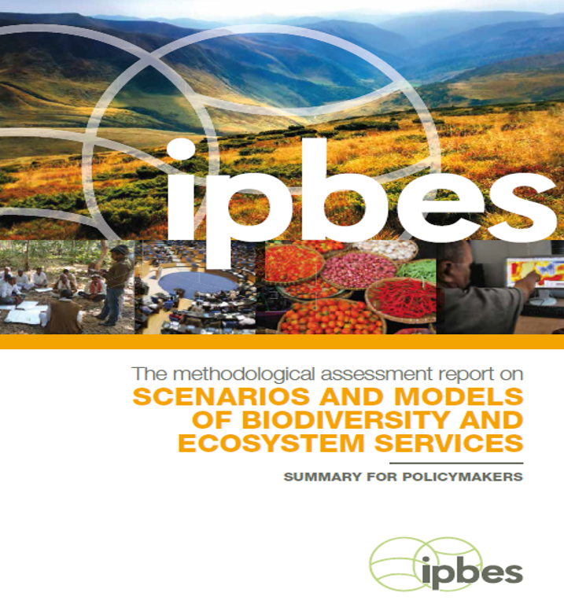
Summary for Policymakers: high-level messages
High-level message 1: Scenarios and models can contribute significantly to policy support, even though several barriers have impeded their widespread use to date
High-level message 2: Many relevant methods and tools are available, but they should be matched carefully with the needs of any given assessment or decision support activity, and applied with care, taking into account uncertainties and unpredictability associated with model-based projections
High-level message 3: Appropriate planning, investment and capacity-building, among other efforts, could overcome significant remaining challenges in developing and applying scenarios and models
Notes:
Let’s now look more closely at the structure of the Summary for Policy Makers (or SPM), which will be the main focus of the remainder of this presentation
The SPM first presents the 15 Key Findings of the assessment, structured under 3 High-level Messages – i.e. …
These Key Findings are then followed by 6 points of “Guidance for science and policy” , which are intended for the broader audiences I described earlier
The SPM then concludes with another 6 points of guidance targeted more specifically towards IPBES and its task forces and expert groups
You will probably be pleased to hear that I am not attempting to discuss all 27 key findings and guidance points in the remainder of this presentation!
Instead I will focus on a selected subset of these findings and guidance points which have particularly important implications for the future development and use of scenarios and models of biodiversity and ecosystem services within and beyond IPBES
11

Slide 12
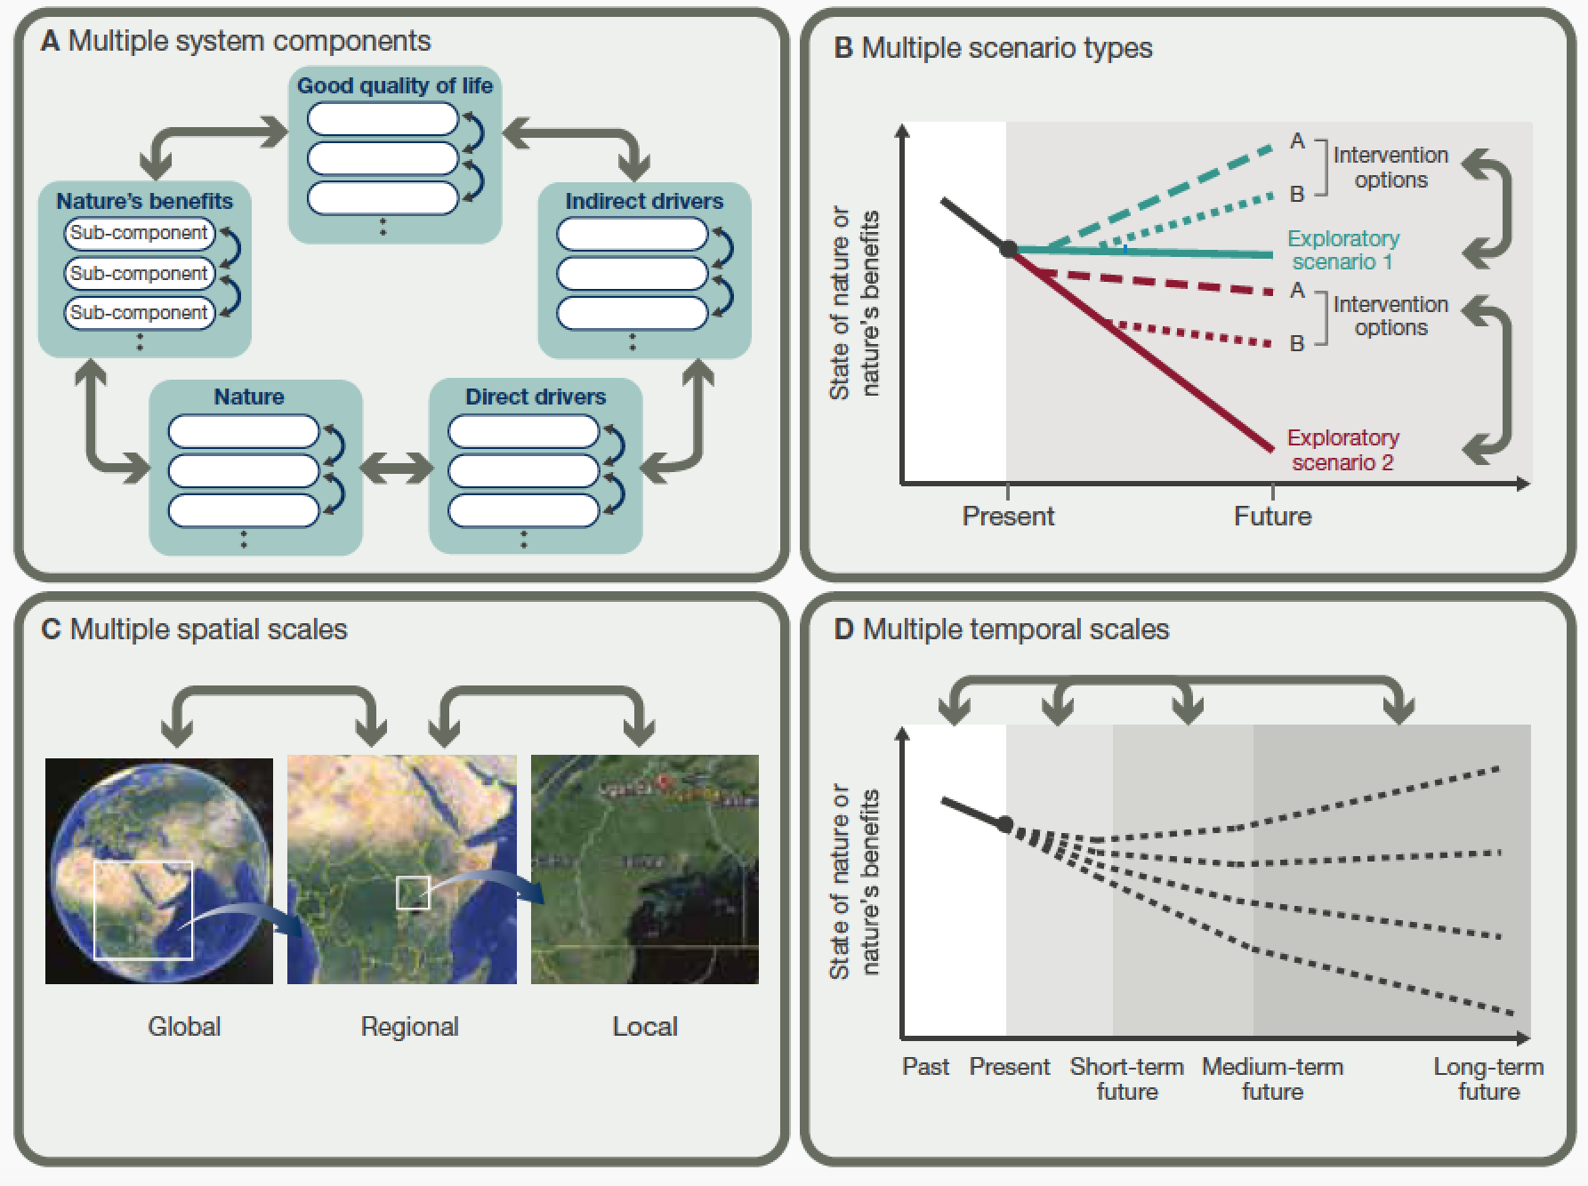
What should we aim for?
BD & ES central
Participatory
Multi-scale
Across realms
International agreements
IPBES 2016

Slide 13
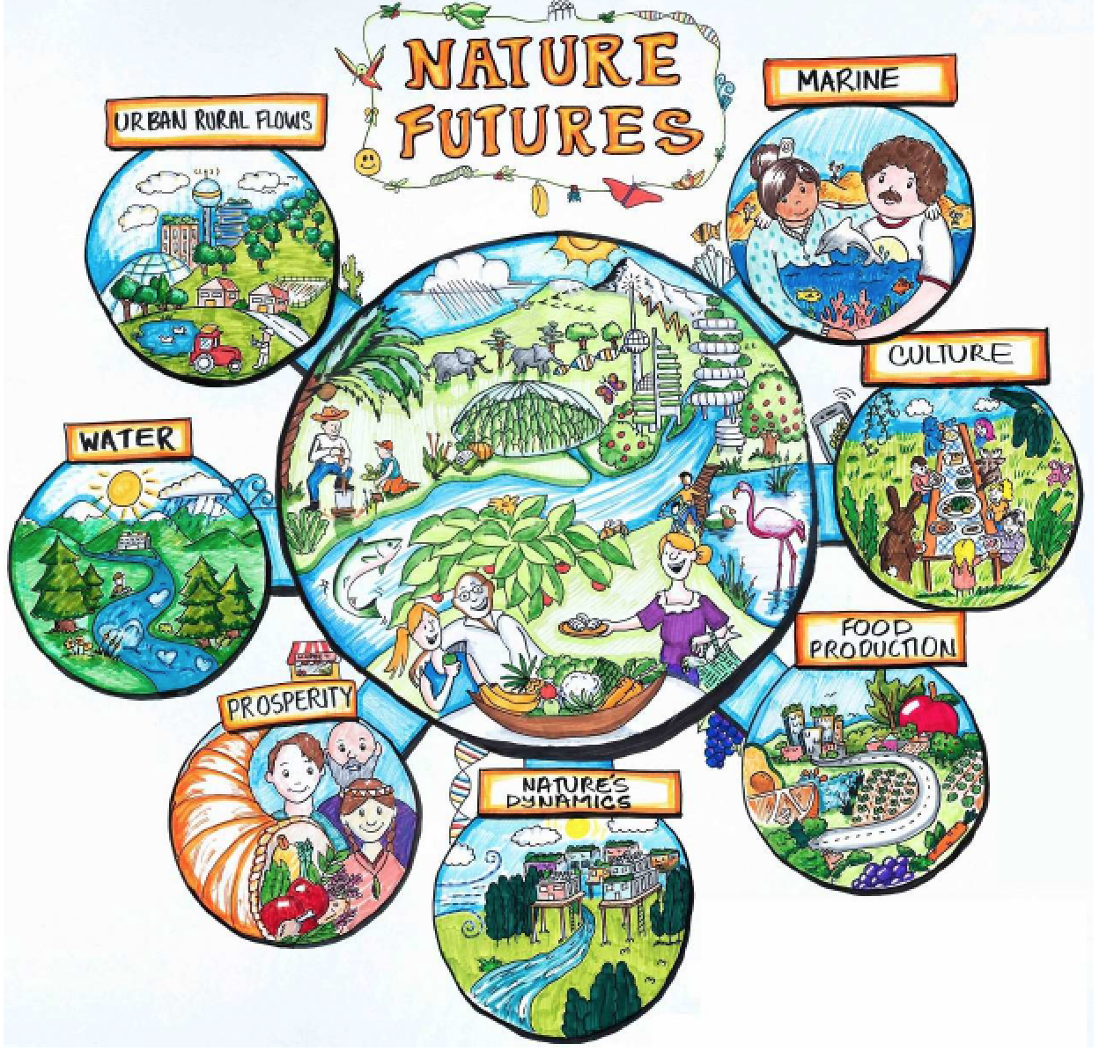
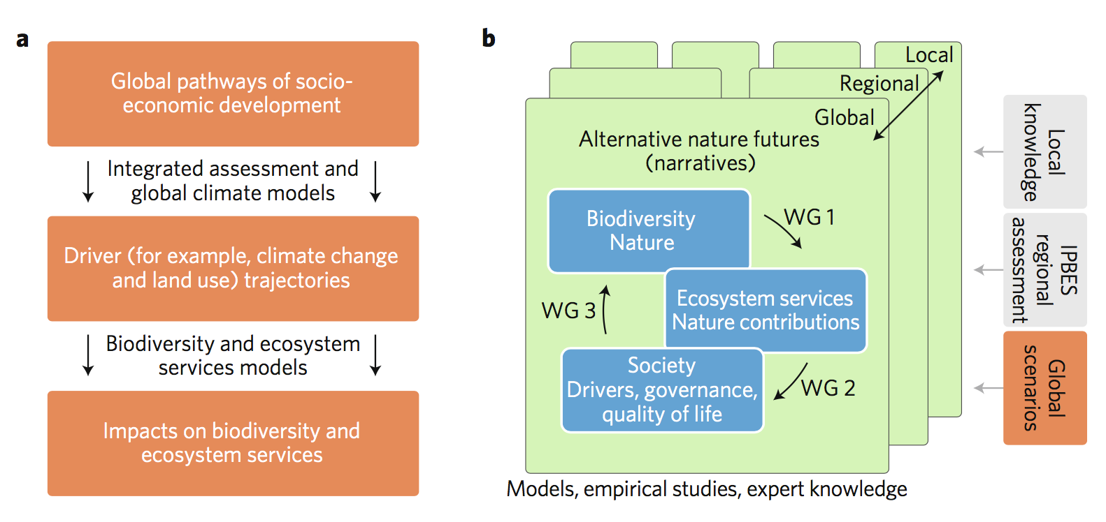
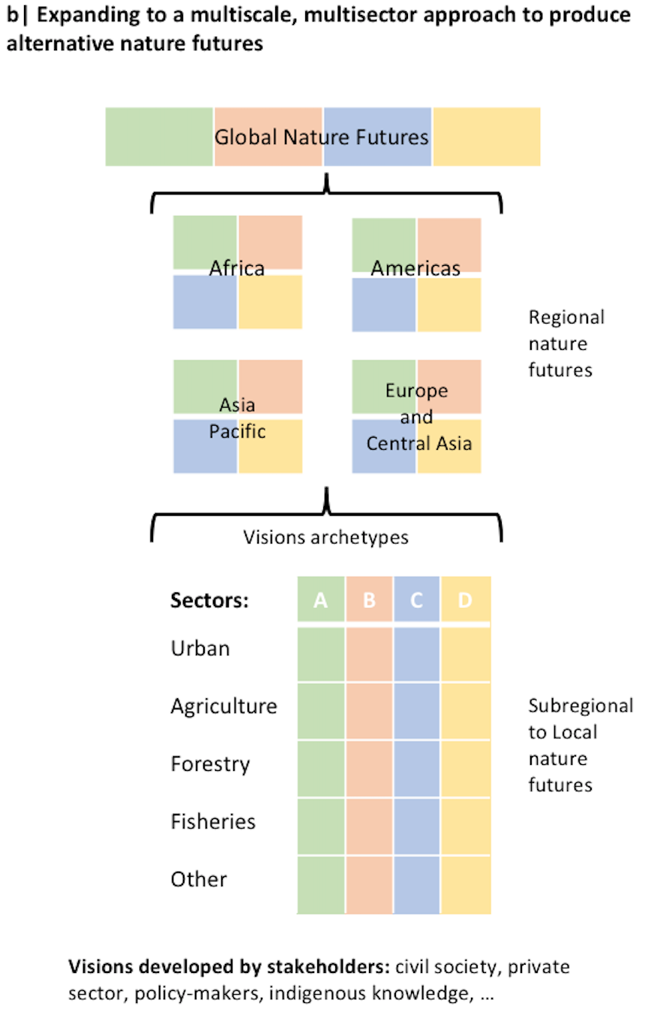
Put nature at the center
Demand for biodiversity and ecosystem services scenarios
a) Collaboration with the climate change modelling community to inform ongoing Global Assessment (in SPM now)
b) Ambitious effort to delineate multi-scale ’nature futures’ in all IPBES regions
Activity part of the IPBES Scenarios and Models Expert Group
Rosa et al. 2017
Nature Eco. Evo.
Lundqvist et al. 2018
in prep.

Slide 14
OK...
But how do we actually create a scenario?
Or in other words:
How can we estimate future changes in biodiversity and/or ecosystem services?

Slide 15
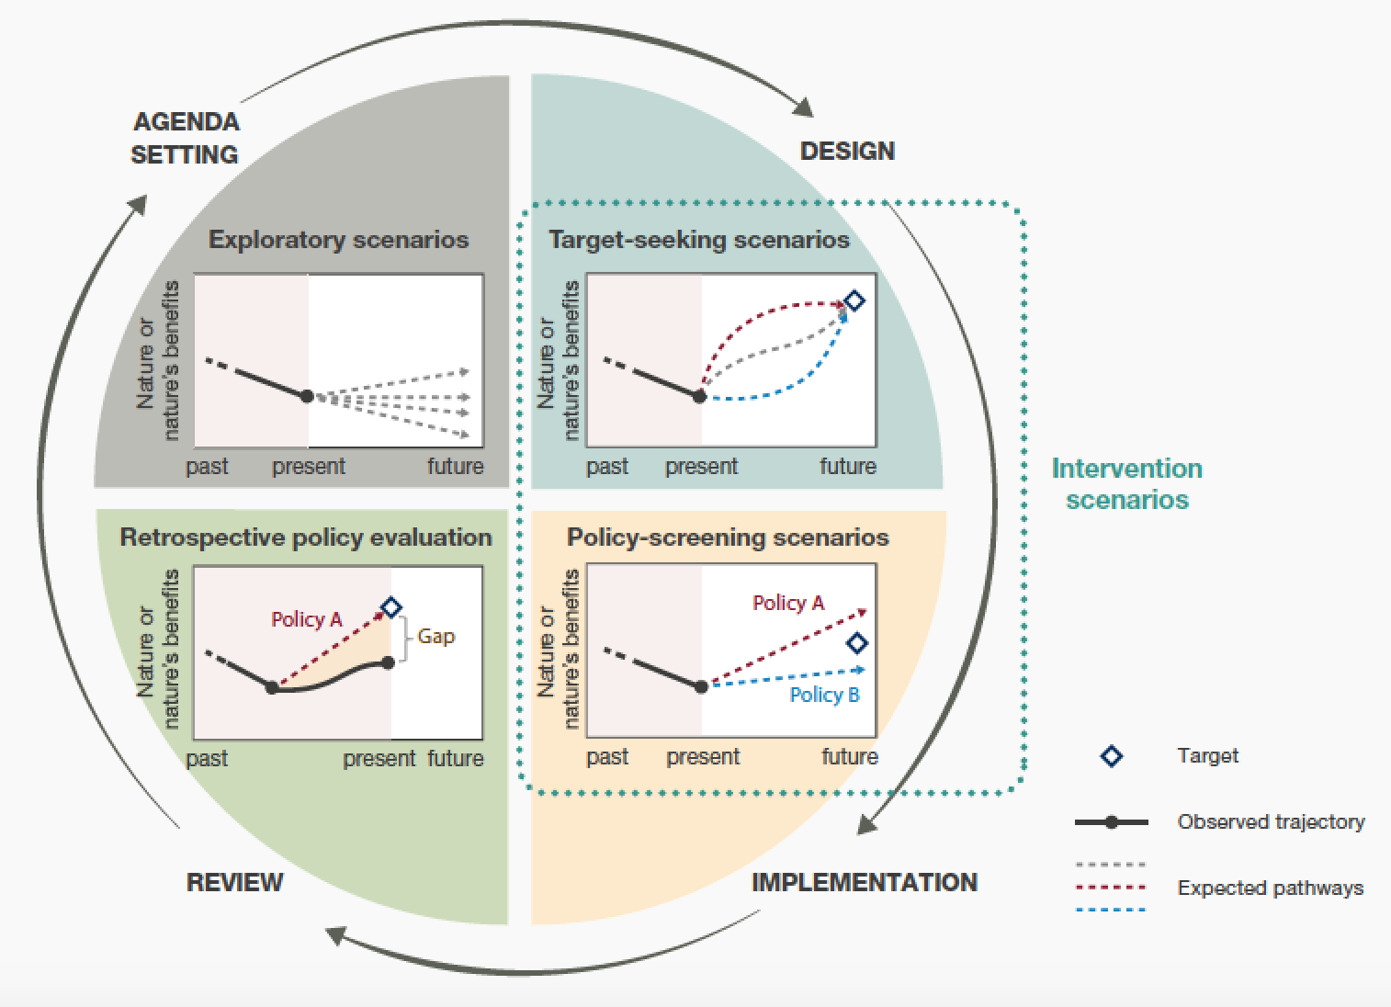
Depends...

Slide 16
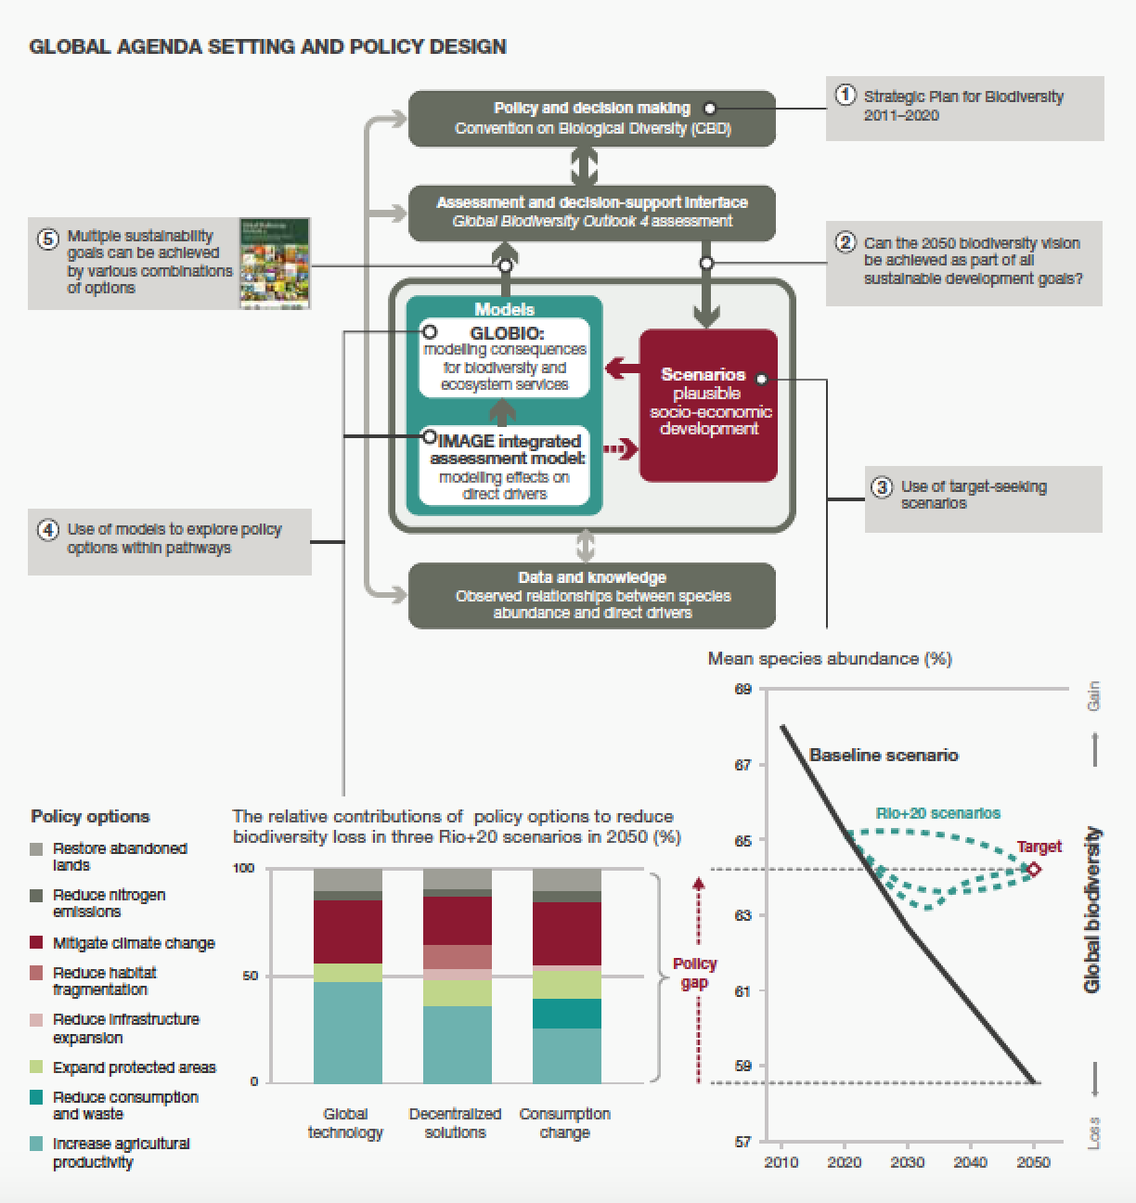
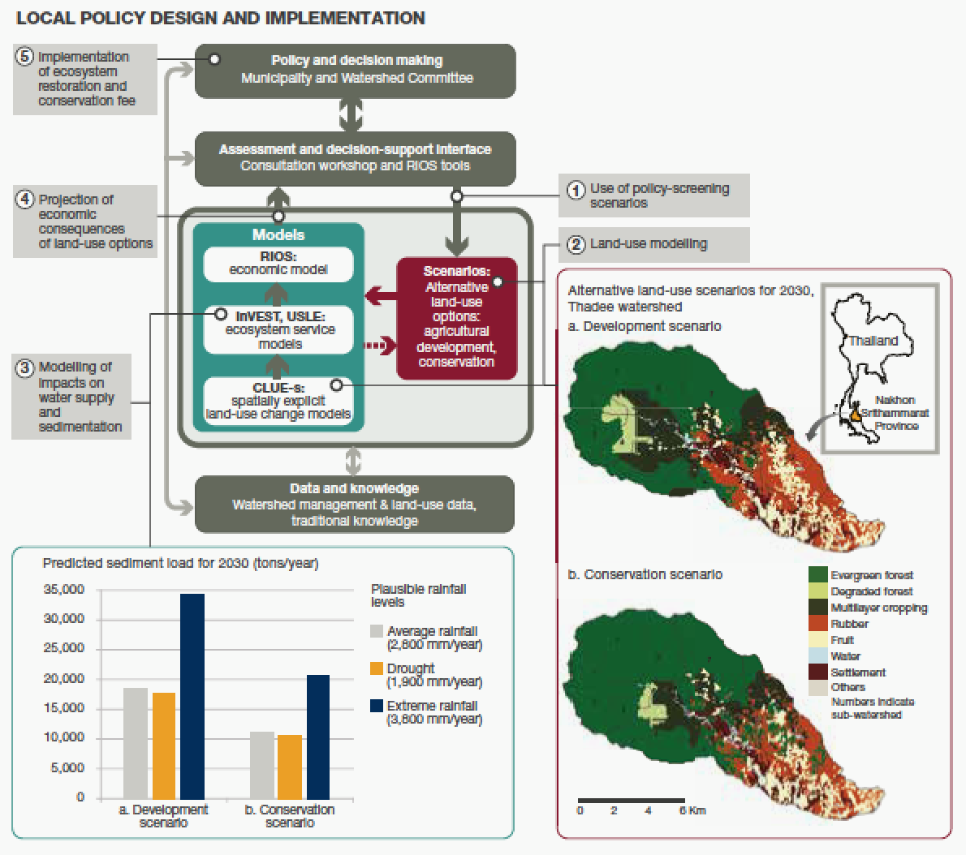
The issue of scale!

Slide 17
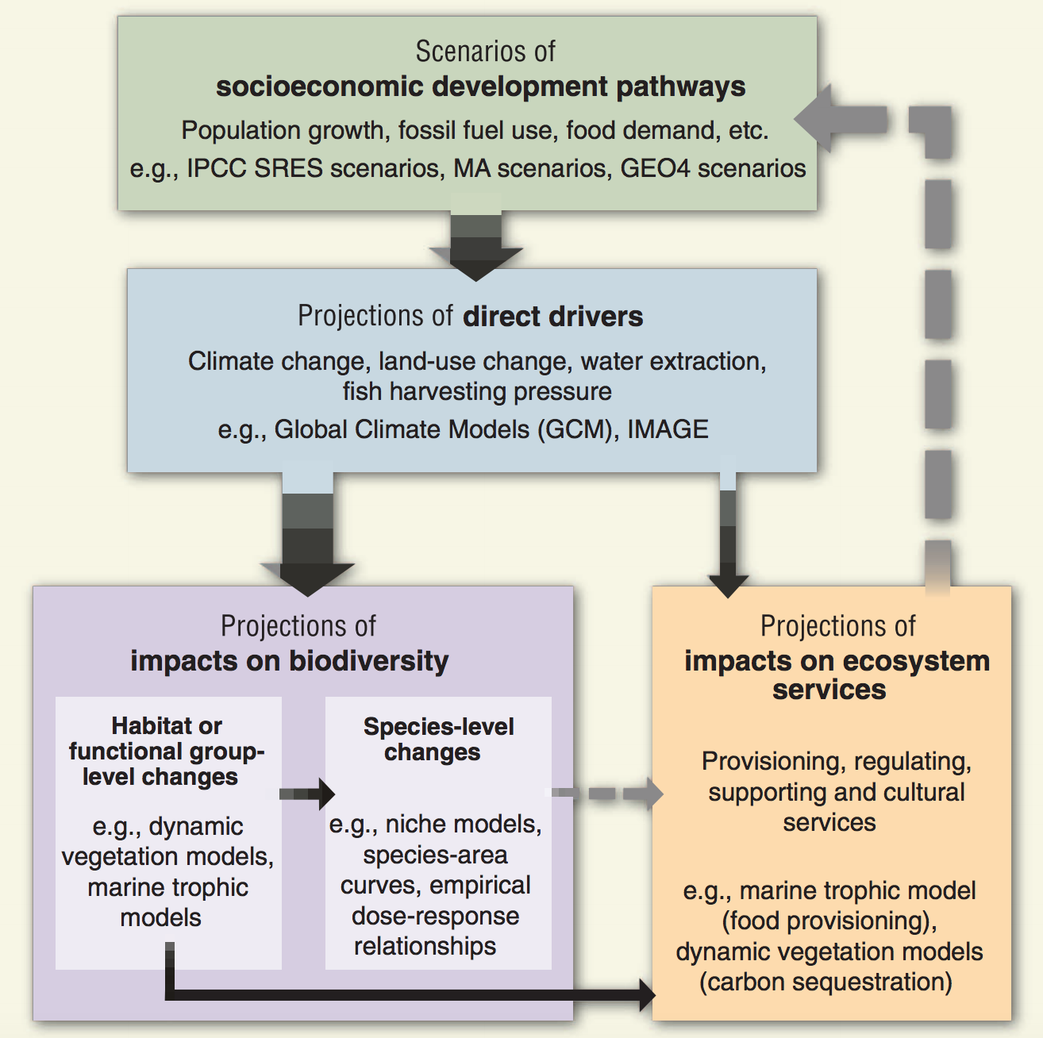
How to create a scenario?
Pathways of development
Population growth
Fossil fuel usage
Projection of direct drivers
Land use change
Climate change
Impact on biodiversity & ES
End point of analysis
No feedback interaction

Slide 18
Narrative development
The Shared Socio-economic Pathways (global)
Regional narratives
Participatory scenario workshops are useful for producing site-specific narratives that articulate how potential future global change is perceived by local and regional stakeholders and form the basis for so-called extended socioeconomic pathways.

Slide 19
Global Narratives Development
The SSPs describe plausible alternative trends in the evolution of society and natural systems over the 21st century at the level of the world and large world regions.
Incorporation of information typically used as input assumptions by integrated assessment models of the global energy-economy-land use system, or by global-scale climate impact models of different sectors.
The result of an iterative process within the climate sciences community
Information sufficient to support elaboration or extension of global assumptions to local- and regional-scale scenarios.
Riahi et al 2017 GCB, O‘Neill et al. 2015 GEC

Slide 20
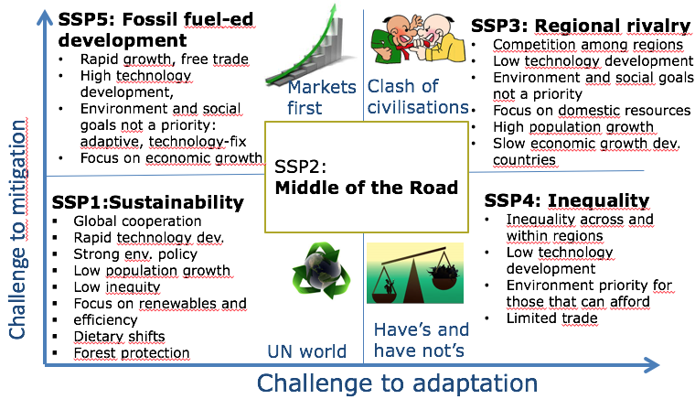
Let’s walk through a global example
Shared socioeconomic pathways
narrative descriptions of future societal development
(O’Neill et al. 2015 Glob. Env. Ch.)
Used in climate change models
Faster to implement
Provide global context to regional approaches
Kok et al. 2016 (Sustainable Science) “SSPs as a basis to preparation of global IPBES scenarios”

Slide 21
Translation to quantitative metrics
Integrated Assessment Models (IAMs)
http://sedac.ciesin.columbia.edu/mva/iamcc.tg/mva-questions.html
Input the narratives, and transform them into quantitative outputs through different interacting modules
Demand for agricultural and forestry products
Output projected global land use change
Very coarse resolution

Slide 22
SSPs (Energy)
2500
2500
Other renewables
SSP5
(Fossil-fueled
growth)
Other renewables
2000
Nuclear
2000
Nuclear
Gas
Gas
SSP3
(Regional rivalry)
Oil
Oil
1500
Coal
1500
Coal
EJ
Biomass
EJ
Biomass
1000
1000
2500
500
Other renewables
500
Nuclear
SSP2
(Middle of the road)
2000
Gas
0
Oil
0
1850
1900
1950
2000
Coal
2050
2100
1850
1900
1950
2000
2050
2100
1500
EJ
Biomass
1000
2500
2500
Other renewables
500
Other renewables
2000
Nuclear
2000
Nuclear
Gas
0
Gas
SSP4
(Inequality)
Oil
1850
1900
1950
2000
Oil
2050
2100
1500
Coal
SSP1
(Sustainability)
1500
Coal
EJ
Biomass
EJ
Biomass
1000
1000
2050
500
500
0
0
1850
1900
1950
2000
2050
2100
1850
1900
1950
2000
2100

Slide 23
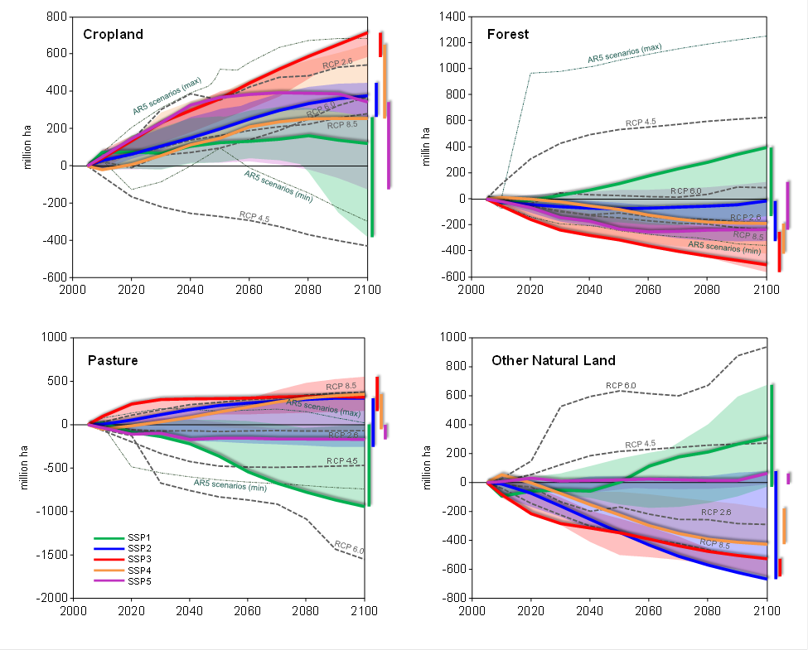
Land area (million ha)
Wide range from rewilding in the SSP1 to continious expansion of human-dominated area in SSP3
Popp et al. 2016

Slide 24
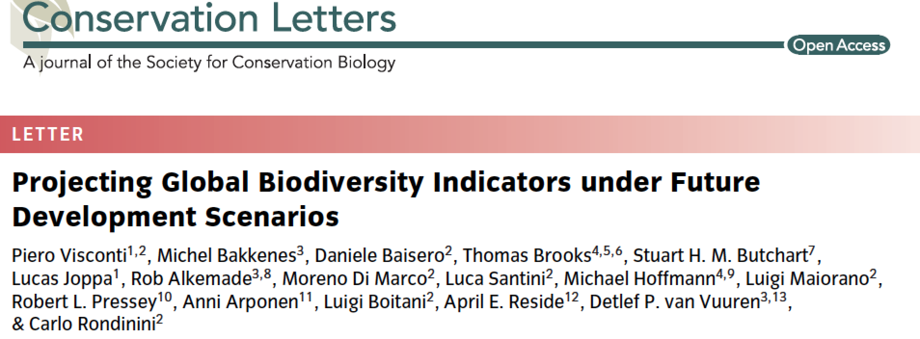
From land use to biodiversity
More on this with Inês tomorrow

Slide 25
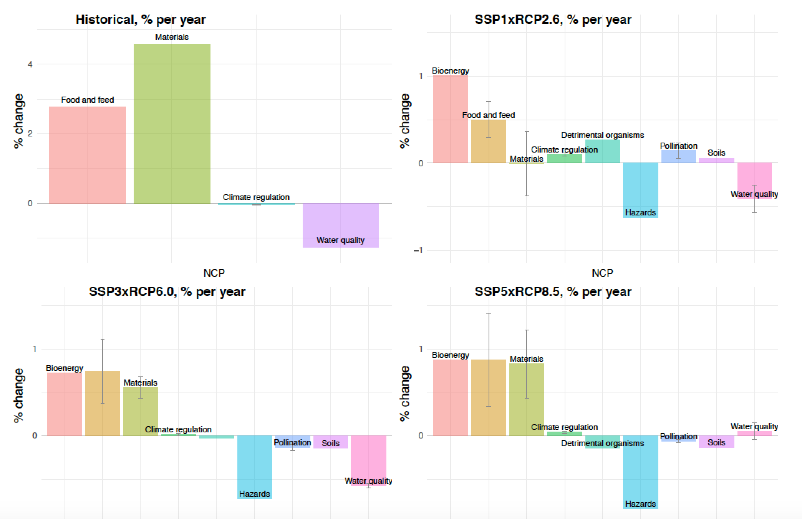
From land use to ecosystem services

Slide 26
But how about BD <-> ES?
We‘re not there yet...
Neither are we in terms of accounting for feedbacks in these models, i.e. a change in biodiversity (e.g., pollinators) impact land use dynamics (e.g., agricultural lands), that then impacts markets (e.g., demand for products)

Slide 27
In today‘s class
Land use and land cover change modelling at regional scale
Go through an example of a data-driven land cover change model

Slide 28
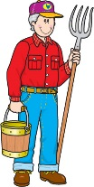
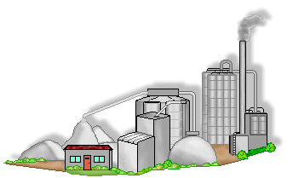







All models are wrong; but some are useful! George E. P. Box
Farm-level LCC
Regional LCC
Global LCC
SCALE (trade-off)

Slide 29
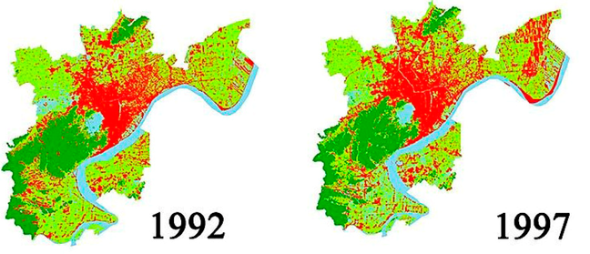
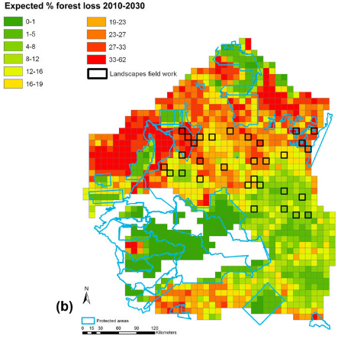
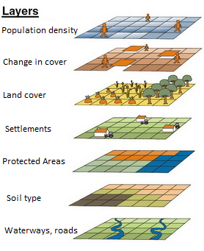
How do these models work?
Land Use and Land Cover Change Model
Demand module
How much is likely to change?
Underlying causes
Allocation module
Where it will change?
Proximate causes

Slide 30
One vs Multiple transitions

Slide 31
One transition only
What’s happening in the landscape you want to study?
Time 0 |  |  |  | Time 1 |  |  |  |  |  |  | Forest
 |  |  |  |  |  |  |  |  |  |  | Deforested
F | D | F |  | F | D | D
F | D | F |  | F | D | D
F | F | F |  | F | F | F
We will be focusing on this example in the practical
Single transition: forest to deforested (no way back)

Slide 32
Multiple transitions (no competition)
Time 0 |  |  |  | Time 1 |  |  |  |  |  |  | Forest
 |  |  |  |  |  |  |  |  |  |  | Deforested
F | D | F |  | D | D | F
F | D | F |  | F | F | F
F | F | F |  | F | F | F
Multiple (simultaneous) transitions, no competition:
forest to deforested;
deforested back to forest.

Slide 33
Multiple transitions (with competition)
Time 0 |  |  |  | Time 1 |  |  |  | Forest
 |  |  |  |  |  |  |  | Deforested
C | C | D |  | S | C | D |  | Cattle ranching
S | S | D |  | C | S | D |  | Soybean plantation
F | F | F |  | D | D | F
Multiple (simultaneous) transitions, with competition:
forest to deforested;
deforested to cattle or soybean;
cattle back to forest or converted to soybean;
soybean back to forest or deforested.

Slide 34

What drives land use change?
“Proximate causes are human activities or immediate actions at the local level, such as agricultural and road expansion, that originate from intended land use and directly impact forest cover.”
“Underlying driving forces are fundamental social processes, such as agricultural policies, that underpin the proximate causes and either operate at the local level or have an indirect impact from the national or global level.”
(Geist and Lambin 2002)
Easier
Harder
Which ones do you think
will be easier to
represent in a model?

Slide 35
You‘re right ☺
Rosa et al. 2014 Global Change Biology

Slide 36
Collection of Spatial Datasets

Slide 37
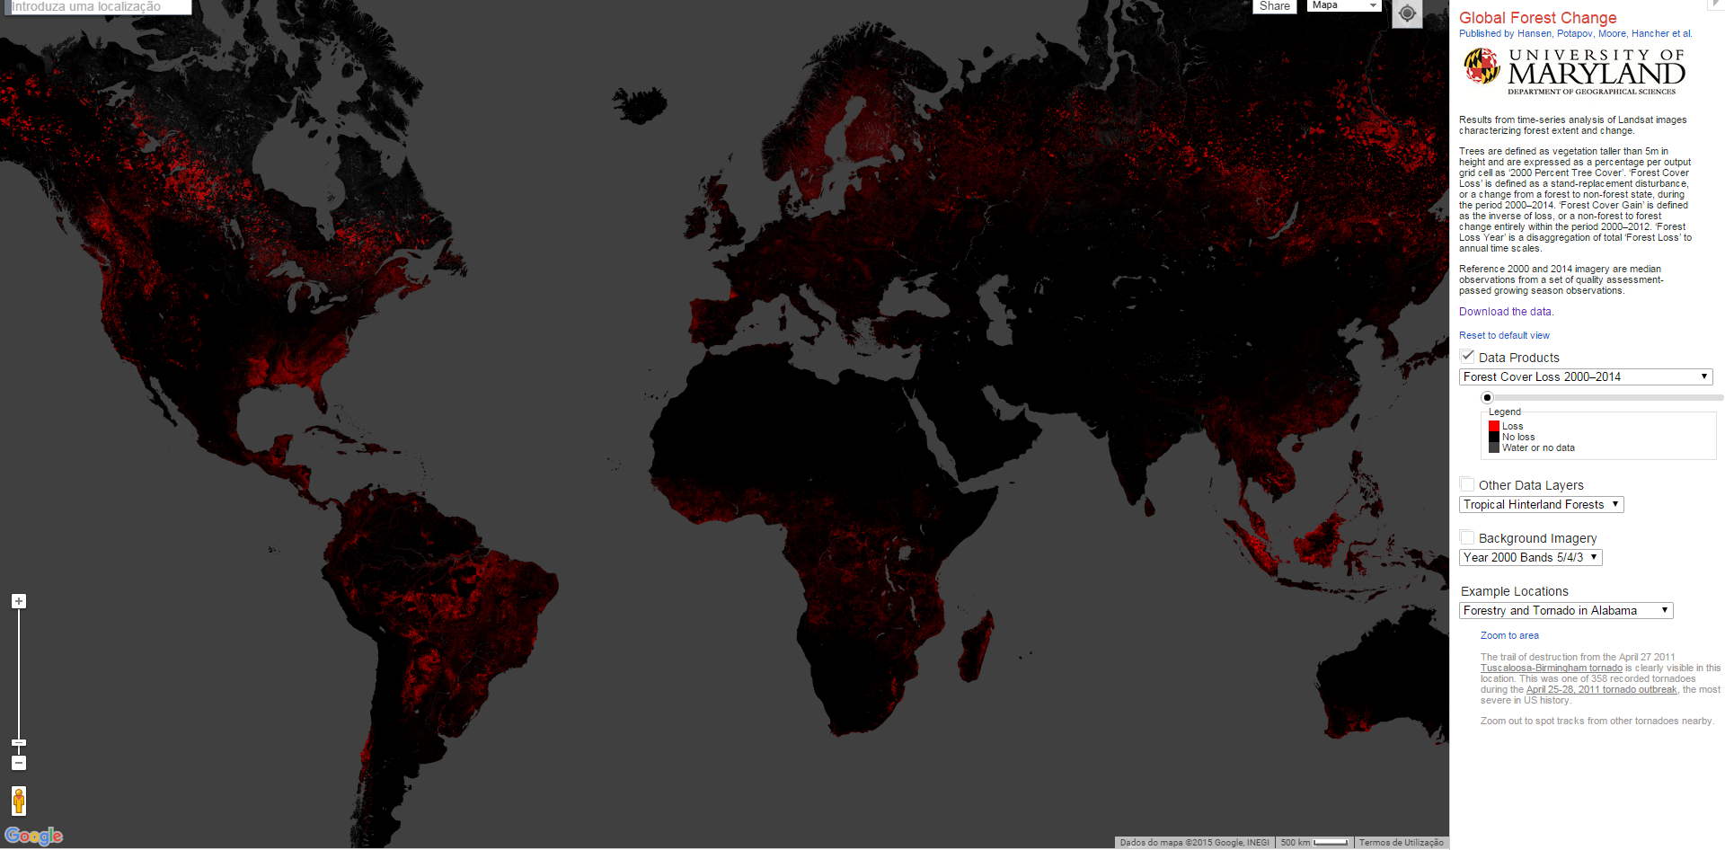
Where can I find datasets?
Forest cover change:
http://earthenginepartners.appspot.com/science-2013-global-forest

Slide 38
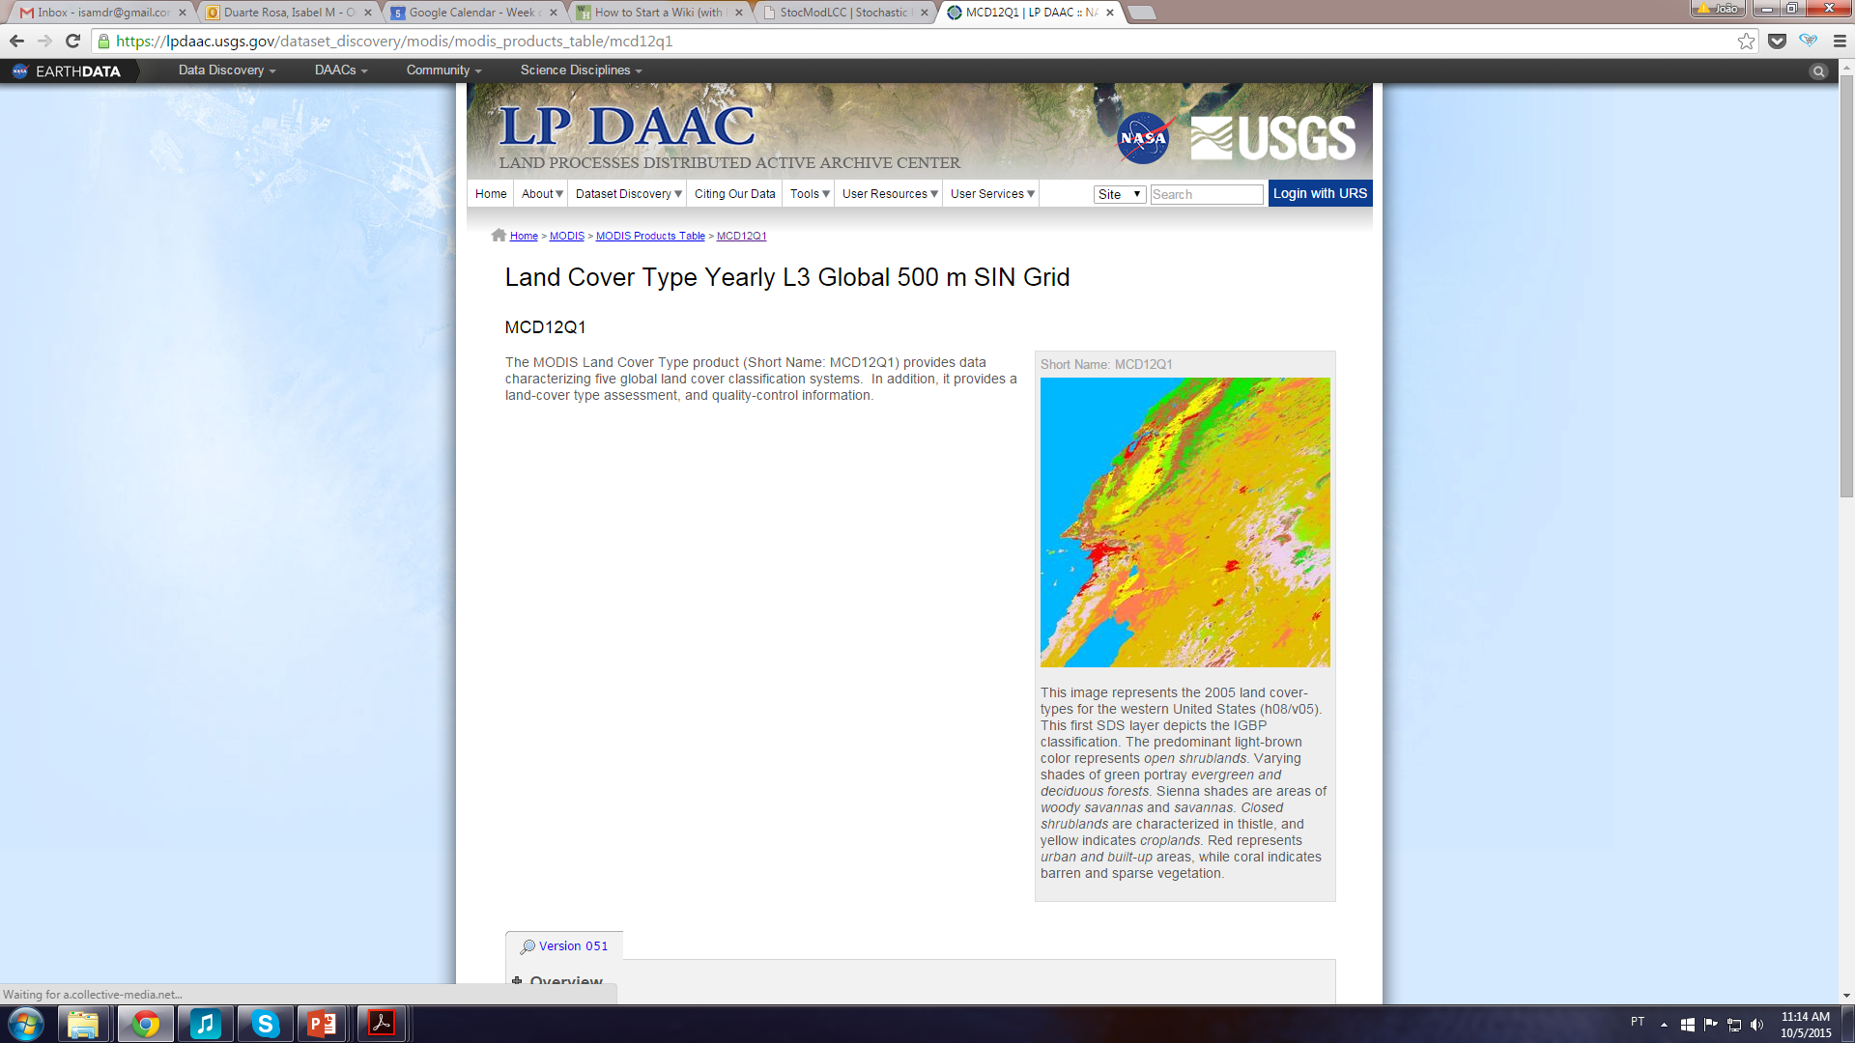
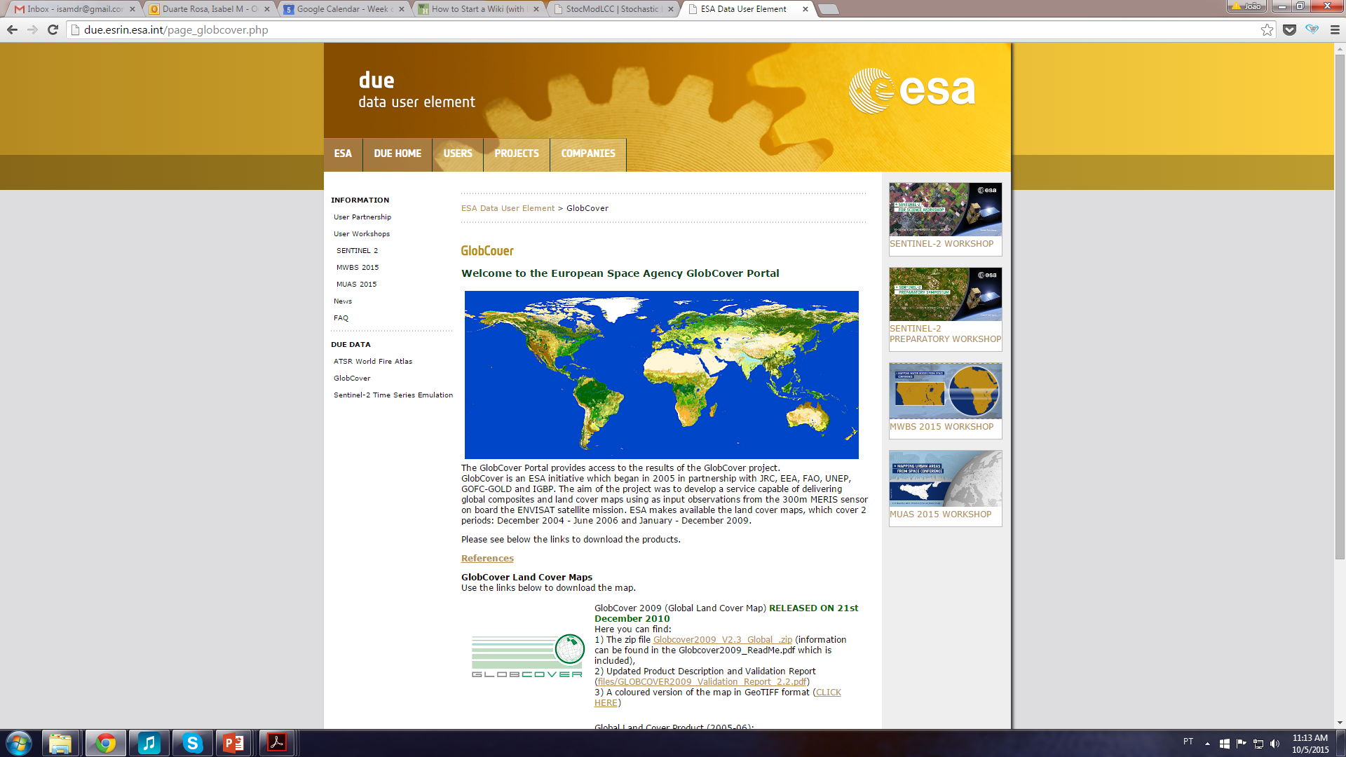
Where can I find datasets?
Land Cover: http://due.esrin.esa.int/page_globcover.php
https://lpdaac.usgs.gov/dataset_discovery/modis/modis_products_table/mcd12q1
https://www.esa-landcover-cci.org/
Very rapid field at the moment!
Keep an eye out for new datasets
Better spatial, temporal and thematic resolutions

Slide 39
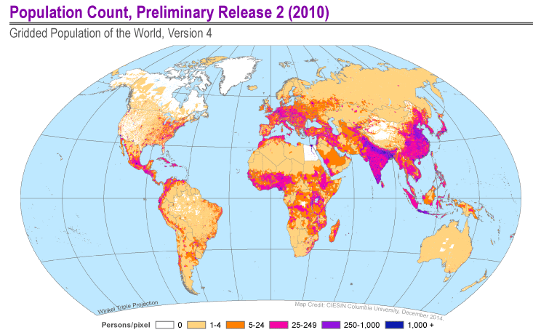
Where can I find datasets?
Human population (national census):
http://sedac.ciesin.columbia.edu/data/collection/gpw-v3

Slide 40
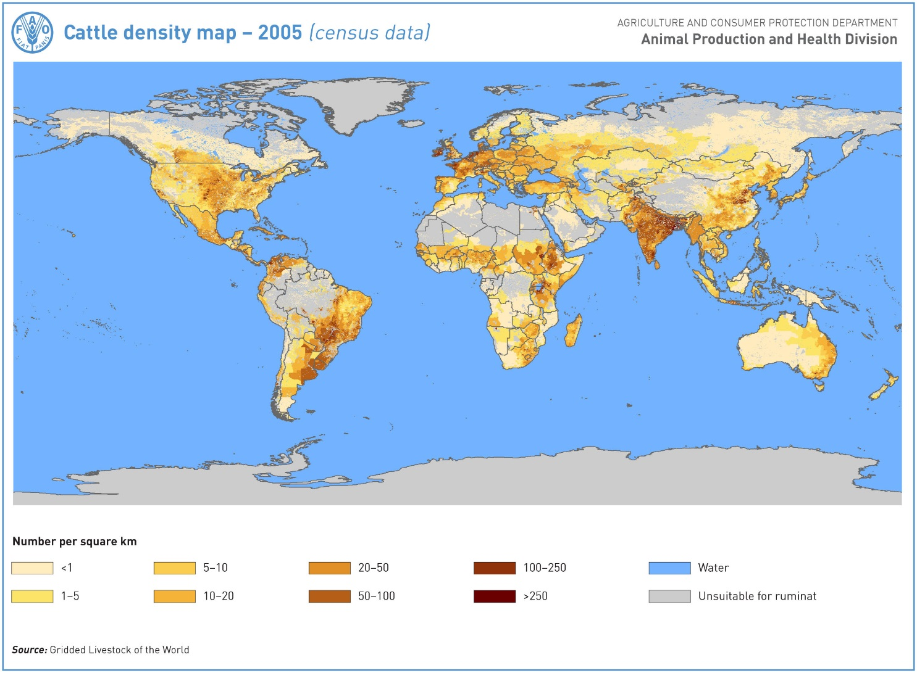
Where can I find datasets?
Cattle density (try national institutes as well, IBGE in Brazil):
http://www.fao.org/ag/againfo/resources/en/glw/GLW_dens.html

Slide 41
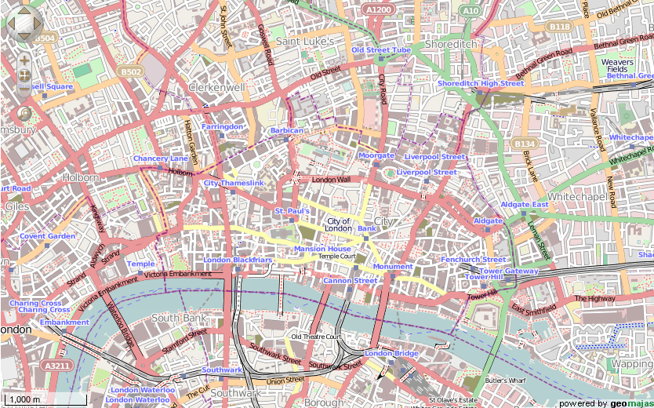

Where can I find datasets?
Roads: https://www.openstreetmap.org/
Lots of citizen science projects showing up.

Slide 42
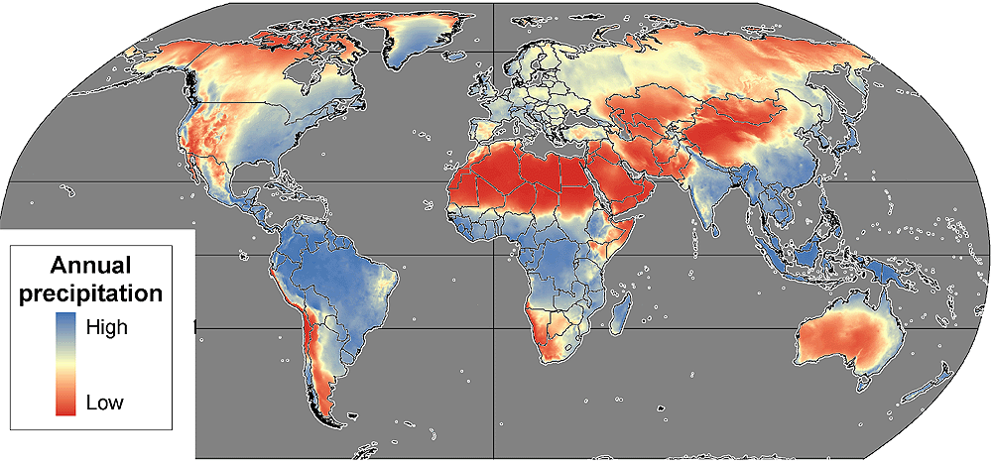
Where can I find datasets?
Climate data: http://www.worldclim.org/, ISI-MIP, CHELSA

Slide 43
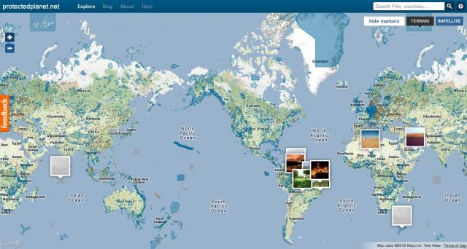
Where can I find datasets?
Protected Areas: http://www.protectedplanet.net/

Slide 44
Where can I find datasets?
Among many others such as...
Rivers: http://www.diva-gis.org/gdata
National Statistics Institutes (tabular data that you can combine with a spatial layer of administrative boundaries using QGIS or ArcGIS)
GDP
Agricultural production
Employment
Education
Industry
Etc.
I got the data, now what?

Slide 45
I know what I want to project
I collected the data that I want to use
What‘s next?

Slide 46

Two key aspects being modeled
The rate of change (how much?) – determine the area (or number of pixels) that will change from one land cover to another; imposed or estimated
The location of change (where?) – suggest where the estimated change will occur in the landscape;
Demand (economic drivers)
Allocation (landscape)
Some will do, others won’t

Slide 47
Rate of Change
Imposed (top-down) – from historical trends or assuming certain variations in future demand that leads to changes in amount of land being converted
N = X pixels, pixels with highest probabilites (from allocation module are selected to change)
Estimated (bottom-up) – the model uses the input data to estimate expected number of pixels that will change. More reliant of quality data.
N = f(inputs), pixels with highest probabilites will change more often (allocation/spatial module determines both amount and location of change)
Demand (economic drivers)
Allocation (landscape)
Integrated model (landscape)

Slide 48
A conceptual example
1 | 1 | 1 | 1 | 1
1 | 1 | 1 | 1 | 1
1 | 1 | 0 | 0 | 0
1 | 1 | 0 | 1 | 0
1 | 1 | 0 | 0 | 0
0.1 | 0.1 | 0.1 | 0.1 | 0.1
0.1 | 0.2 | 0.6 | 0.5 | 0.7
0.1 | 0.5 | 0 | 0 | 0
0.1 | 0.6 | 0 | 0.8 | 0
0.1 | 0.6 | 0 | 0 | 0
Initial Forest/Non-Forest Map in t0
Probability of conversion (coming from a model):
Depends on past deforestation
Distance to roads
Socioeconomic factors
Existance of protected areas
Etc.

Slide 49
A conceptual example
1 | 1 | 1 | 1 | 1
1 | 1 | 1 | 0 | 0
1 | 1 | 0 | 0 | 0
1 | 1 | 0 | 0 | 0
1 | 1 | 0 | 0 | 0
0.1 | 0.1 | 0.1 | 0.1 | 0.1
0.1 | 0.2 | 0.6 | 0.5 | 0.7
0.1 | 0.5 | 0 | 0 | 0
0.1 | 0.6 | 0 | 0.8 | 0
0.1 | 0.6 | 0 | 0 | 0
Future Forest/Non-Forest Map in t1
Rate estimated: 3 pixels change state
Probability of conversion (coming from a model):
Depends on past deforestation
Distance to roads
Socioeconomic factors
Existance of protected areas
Etc.

Slide 50
A conceptual example
1 | 1 | 1 | 1 | 1
1 | 1 | 0 | 1 | 0
1 | 1 | 0 | 0 | 0
1 | 0 | 0 | 0 | 0
1 | 0 | 0 | 0 | 0
0.1 | 0.1 | 0.1 | 0.1 | 0.1
0.1 | 0.2 | 0.6 | 0.5 | 0.7
0.1 | 0.5 | 0 | 0 | 0
0.1 | 0.6 | 0 | 0.8 | 0
0.1 | 0.6 | 0 | 0 | 0
Future Forest/Non-Forest Map in t1
Rate imposed: 5 pixels change state
Select those with highest probability
Probability of conversion (coming from a model):
Depends on past deforestation
Distance to roads
Socioeconomic factors
Existance of protected areas
Etc.

Slide 51
Five broad LCC model categories
Statistical – understand the relationship between input data and LCC observed, and then project that same trend;
Cellular automata – strong effect of the local neighboorhood on the future dynamics of LCC;
Agent-based – understand what drives the decisions of the agents involved in the LCC process (usually small scale models);
Optimization – seeking to optimise production or minimise costs (usually small scale models);
Other – rule based, neural networks, markov chain, etc.

Slide 52
Softwares out there (by no order)
The Land Change Modeller and GEOMOD within IDRISI http://www.clarklabs.org/
DINAMICA EGO http://www.csr.ufmg.br/dinamica/
CLUE, CLUE-S http://www.ivm.vu.nl/en/Organisation/departments/spatial-analysis-decision-support/Clue/index.asp
TerraME http://www.terrame.org/doku.php
LandSHIFT http://www.usf.uni-kassel.de/cesr/index.php?option=com_project&task=view_detail&agid=27&lang=en
FALLOW http://www.worldagroforestry.org/sea/fallow
SITE http://www.ufz.de/index.php?en=19080
StocModLCC www.stocmodlcc.net
Rosa et al. 2014 Global Change Biology

Slide 53
Model (outputs) Validation
Compare with observed data that you haven‘t used in the model for calibration (cross-validation, space for time)
Pixel by pixel (very hard on the models)
Neighboorhood or distance-based
Provide policy and decision makers a confidence estimate attached to your model outputs (intermodel)
Show where your model is capturing well the observed patterns and where it is failing (associate that which specific processes)
Pontius Jr. (a lifetime dedicated to LCC models, and particularly to model validation): http://www.clarku.edu/~rpontius/

Slide 54
Main challenges of LULCC models
Land use and land cover change is incredibly dynamic
Input data that represents well the proximate causes and drivers of LCC is lacking
Correctly calibrate the model to represent the relationships between drivers and LCC
Dynamics of LCC – keeping the parameters static over time is an oversimplification
Regional dependence of LCC and its parameters

Slide 55
Main challenges of LULCC models
Policy changes are really hard to capture and even harder to anticipate
Human behavior and associate economics are extremely hard to predict and have great impact on LCC
Scalability: a model that is developed in one region hardly ever works well in another region due to the specifics of LCC in each region

Slide 56
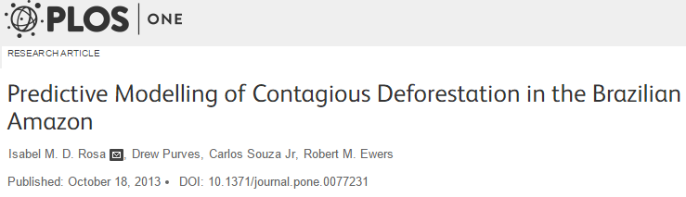
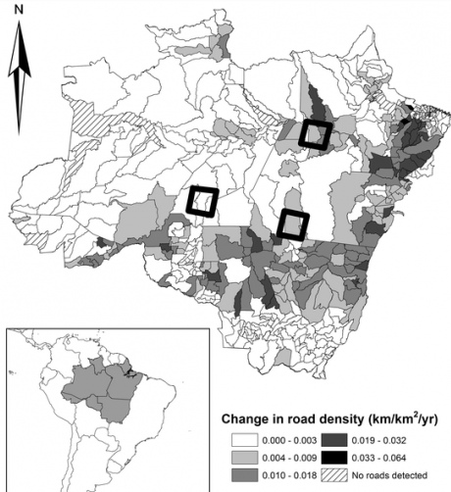
A concrete example in the Brazilian Amazon
Large scale agriculture:
Cattle ranching
Soybean plantation
Road network expansion
(17,000 km/yr)
Protected Areas
(Ahmed et al.2014)

Slide 57
Understanding tropical deforestation
Socio economic fluctuations and policy implementation can impact both the rate and location of land cover change;
Rosa et al. 2012
Cons. Biology
Implementation of policies aimed at preventing illegal deforestation
Dalla-Nora et al. 2014 Land Use Policy

Slide 58
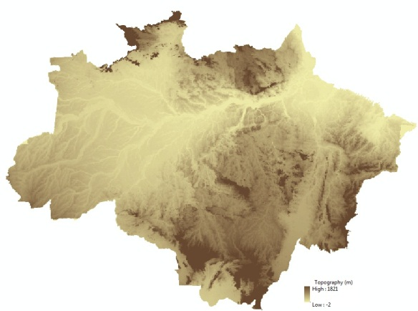
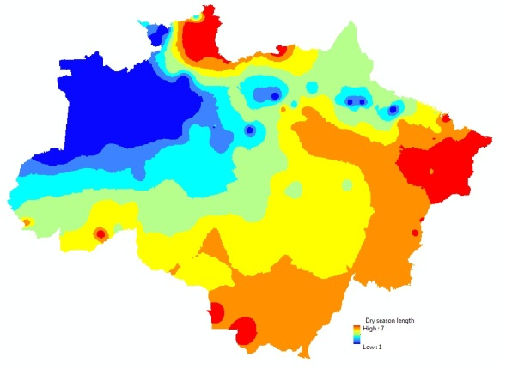
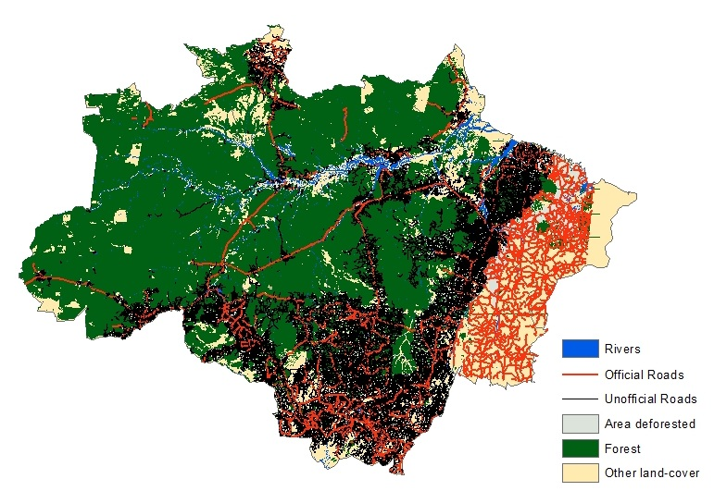
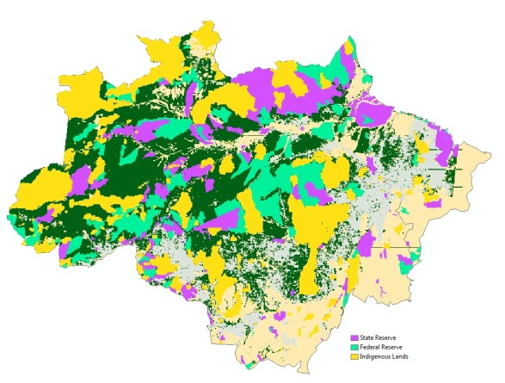
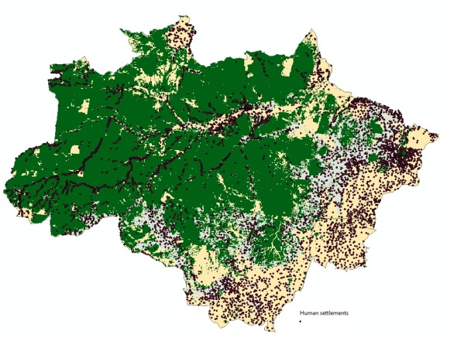
Input variables
Variables used: location of past deforestation, roads, rivers, protected areas, dry season length, changes in total and agricultural GDP, distance to settlements, soil fertility, states

Slide 59
Model flowchart
Rosa et al. 2013 PLOSOne

Slide 60
Probability of deforestation by 2050

Slide 61
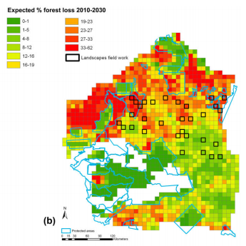
Projecting biodiversity loss
Tree cover threshold for decline in species richness
(piece-wise regression in R)
Areas under greatest risk of future collapse
Direct conservation management or landscape planning
Ochoa-Quintero, Rosa
et al. 2015 Cons. Biol

Slide 62
Learning outcomes
Understand what a land cover change model is;
Understand how LCC models work in general;
Learn where to download data layers to be used as input for spatial LCC models;
Learn to focus on what exactly you’ll be modeling (scale, transitions, extent, proximate causes and drivers, etc.)

Slide 63
Learning Outcomes
Learn to interpret a land cover change model output, and to critically assess its implementation;
Understand the challenges of running a land cover change model and its limitations.
Acquire skills to be able to simulate several scenarios of future land cover change, based on historical data

Slide 64
Now it‘s your turn:
R Markdown
You‘ll use the outputs of today‘s class in tomorrow‘s class.
If there‘s no time to finish everything, there‘s a folder called „solution“ where you can find my own solution and associated output files.

